Slide 1
Uncertainty-Calibrated Graph Neural Networks for Wildfire Spread Prediction under Stochastic Simulation

Slide 2
Address
https://www.sciencedirect.com/science/article/pii/S2352340925010248
https://zenodo.org/records/17579289
Wildfires cause massive environmental and economic damage
Prediction alone is not enough
Decisions require:
Reliable estimates
Uncertainty awareness
Actionable insights

Slide 3
About dataset
Target Variable
Burn Probability (per spatial cell)
Range: ~0 to 0.25
Highly skewed toward low values
Input Features
CFL (Canopy Fuel Load)
FSP Index
Ignition Probability
Structural Exposure Index
Fuel Models (categorical)
Data Type
Raster-based geospatial data
Converted into graph structure

Slide 4
Gaps
Simulation = real-world uncertainty ignored
Poor calibration (overconfident models)
No intervention modeling

Slide 5
Graph Representation
Nodes: 300K spatial cells
Edges: ~1M (8-neighbor connectivity)
Features: 7 per node
Feature Composition
Continuous: CFL, FSP, Ignition, Structural Exposure
Categorical: Fuel Models (24 classes)
Spatial: row_norm, col_norm
Data Processing
Z-score normalization (mean ≈ 0, std ≈ 1)
No missing / invalid values
All rasters aligned to common grid
Target Characteristics
Burn probability ∈ [0, 0.25]
Highly skewed (most values near zero)
Imbalanced regression problem

Slide 6
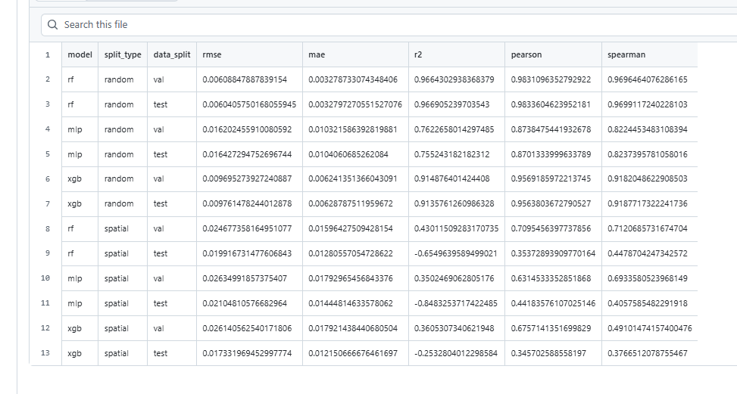
Random Forest , XGBoost, MLP

Slide 7
Critical Insight
Random split is misleading (spatial leakage)
Models fail on unseen regions
Split | Performance
Random Split | High (R² ≈ 0.97)
Spatial Split | Collapse (R² < 0)

Slide 8
CNN Baseline
Objective
Capture local spatial context
Improve over tabular baselines
Approach
15×15 spatial patches
Multi-channel input (5 features)
Stratified sampling (balance target distribution)

Slide 9
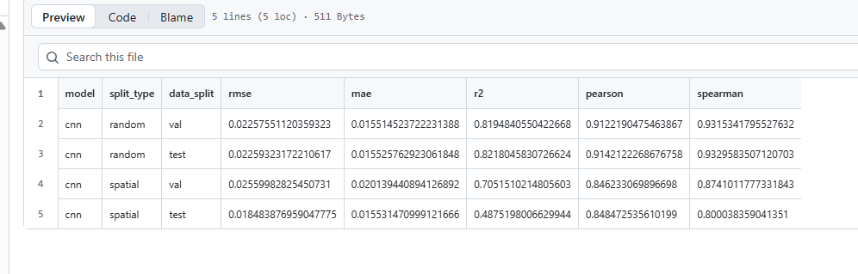
Key Insight CNN captures local patterns Improves generalization Still struggles on unseen regions

Slide 10
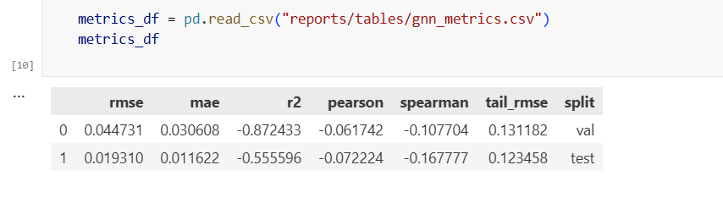
GNN

Slide 11
Why GNN Fails (Current Setup)
Root Causes
Highly imbalanced target (dominant low values)
MSE loss favors near-zero predictions
No stratified sampling (unlike CNN)
Strong spatial distribution shift
Limited local context vs CNN

Slide 12
Future Work & Contribution
Next Steps
Weighted loss
Target transformation
Stratified node sampling
Uncertainty modeling (MC Dropout, NLL)
CNN + GNN hybrid

Slide 13
Phase 6 (Last)
Raster → Graph → GNN → Uncertainty → Intervention → Output

